Slide 1
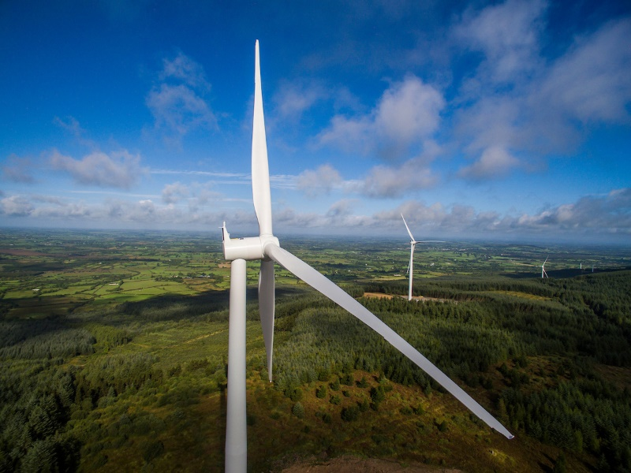
An Bord Pleanála
Ballyfasy Wind Farm Grid Connection, Co. Kilkenny
Pre-Planning Application Update & Design Flexibility Meeting
26. 05. 25

Slide 2

Overview
Introduction to the Project Team
Project Recap
Project Description updates since pre-application meeting on 24th of February 2025
Design Flexibility

Slide 3
Project Team
Developer
Manogate Ltd - a joint venture company established for this project by Art Generation and FuturEnergy Ireland (FEI).
ART Generation Ltd:
Established wind developer in Ireland involved in project development, construction & operation. Recent developments in Tullaroan, Ballybeagh and Ballysloe in Kilkenny.
FEI:
In November 2021, Coillte and ESB joined forces to launch their joint venture company FuturEnergy Ireland. FuturEnergy Ireland’s mission is to maximise the potential of our unique wind and land resources and accelerate Ireland’s transformation to a low carbon energy economy.
*Art Generation Ltd. and FuturEnergy Ireland were involved in the nearby Castlebanny Wind Farm, Co. Kilkenny (ABP Case No. 309306).
Lead Consultants
TOBIN - lead environmental and planning consultants on behalf of Manogate Ltd.
Key EIAR Subs- Macroworks, AWN, Irish Archaeological Consultancy Ltd, Western Forestry Co-Op, Causeway Geotech Ltd.

Slide 4
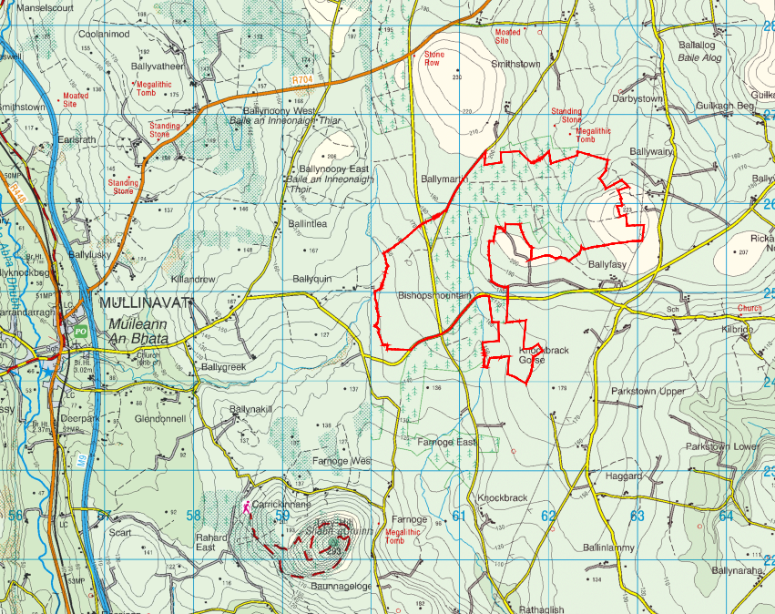

Site Location and Description
The proposed Ballyfasy wind farm is located between the villages of Listerlin to the northeast, Mullinavat to the west, Glenmore to the southeast, and Slieverue to the south.
The wind farm planning application area is approximately 343 hectares and is outlined in red.
The area can be described as rural with dispersed settlement type.
Significant areas of the study area are privately owned grassland and Coillte forestry.

Slide 5
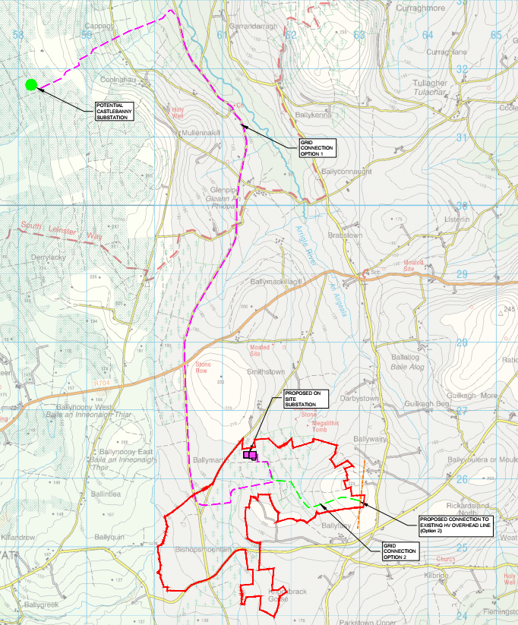
Ballyfasy Wind Farm Grid Connection Options
Two grid connection options are currently being considered. However, only one grid connection option will be constructed for this project.
Grid connection option 1 (purple), the preferred option, proposes to install a 110kV underground cable connection from the proposed Ballyfasy Wind Farm site substation to the consented Castlebanny Wind Farm 110kV substation approximately 12km to the north.
Grid connection option 2 (green) proposes to install a loop in connection to the existing 110kV Great Island-Kilkenny overhead line which passes to the east of the proposed Ballyfasy Wind Farm site.

Slide 6
Site Suitability and Project Description
Project Description
Option 1: Proposed grid connection to the consented Castlebanny Wind Farm substation:
The proposed development will consist of the following elements:
Approximately 12km long 110 kV underground cable grid connection to consented Castlebanny Wind Farm substation.
All related site work, drainage and ancillary works.
Option 2: Proposed loop in grid connection to existing 110kV overhead Great Island-Kilkenny line:
The proposed development will consist of the following elements:
Removal of an existing 110kV pole set on the Great Island-Kilkenny overhead line.
2 new 110kV Overhead Line Cable Interface Masts.
2 circuits of 110kV underground cable (approximately 4km of cable (2 cables x 2km)) from line cable interface mast to the proposed Ballyfasy 110kV loop in substation.
3m wide access track to allow permanent access to the underground cable from line cable interface mast to the proposed loop in substation.
All related site works, drainage and ancillary works.

Slide 7
Design Flexibility
Details Unlikely to be Confirmed at Application Lodgement
Grid Connection Route
Grid Connection Type
The parameters within which the grid connection options will fall are as follows:
Grid Connection Options:
  Approximately 12km long 110kV cable grid connection to the consented Castlebanny Wind Farm Substation.
  Approximately 4km (2 circuits x 2km) of 110kV underground cable and associated infrastructure to loop into existing Great Island – Kilkenny 110kV line.
Grid Connection Types:
  110kV Underground Cable Grid Connection.
  110kV Loop-in Cable Grid Connection.
  Only one grid connection option will be constructed for this project.

Slide 8



Thank You
Galway
Dublin
Castlebar
Limerick
Sligo
Fairgreen House
Fairgreen Rd
Galway,
H91 AXK8
T: (091) 565 211
Block 10-4
Blanchardstown Corporate Park Dublin 15,
D15 X98N
T: (01) 803 0406
Market St
Castlebar
Co. Mayo,
F23 Y427
T: (094) 902 1401
Unit 4, Crescent Court,
St. Nessan’s Road, Dooradoyle, Limerick
V94 V298
T: (061) 574 413
First Floor,
Carroll House,
15/16 Stephen Street
Co Sligo
F91 ADK4
T: (071) 9318 844
www.tobin.ie \

